Slide 1


The Panel consists of investors who enjoy video games (particularly real-time strategy games) that are looking for a game company with a unique concept to invest.
The Panel will think about contributing money in order to earn a share of the game profits.

Slide 2


Slide 3

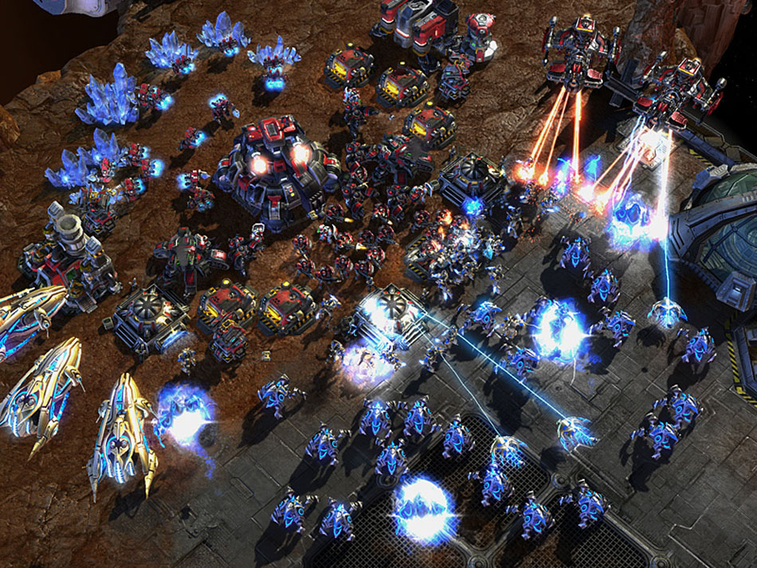
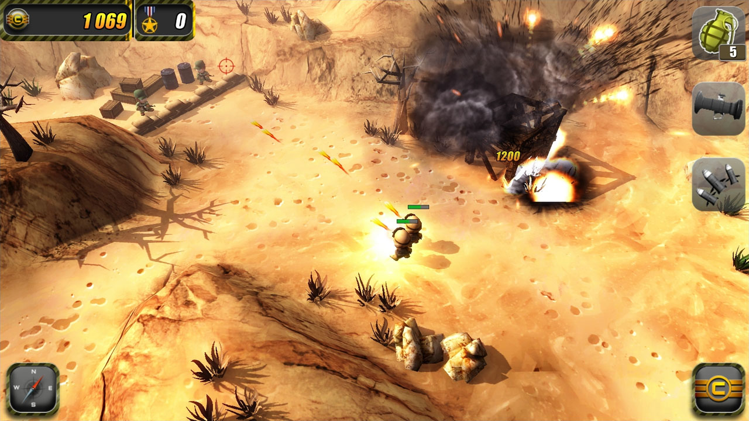
Hard-Core RTS meets Casual Gaming
COMMANDER
COMMANDO
Star Craft 2 Meets Tiny Troopers

Slide 4
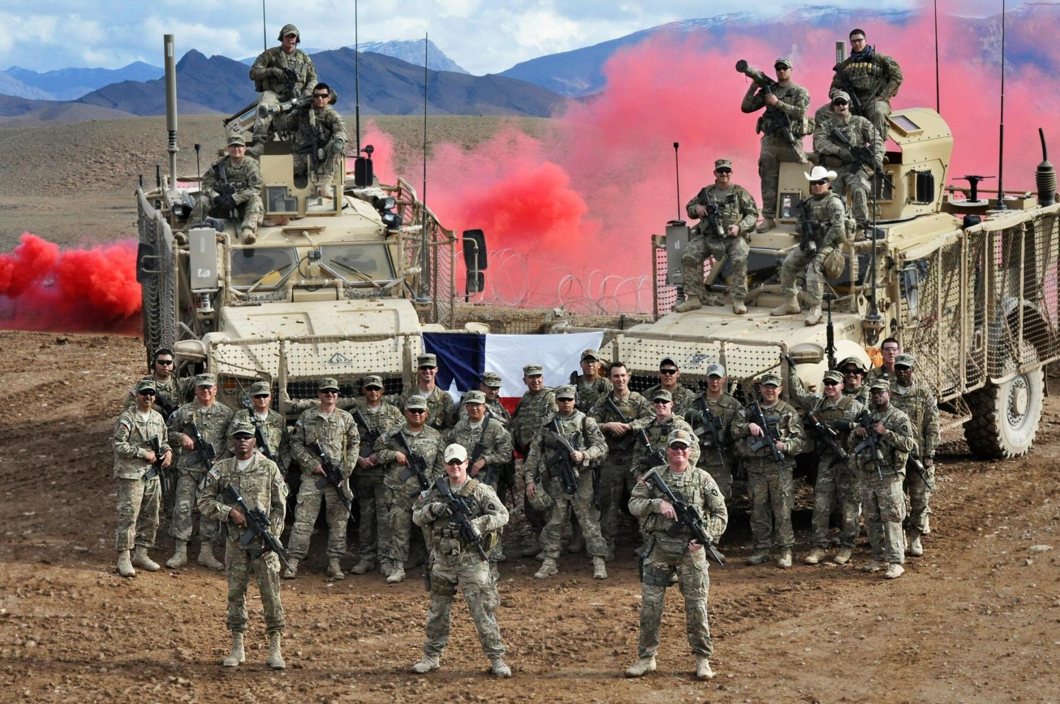

Help your friends defeat the enemy, while waiting in line!
Tap
Tap

Slide 5
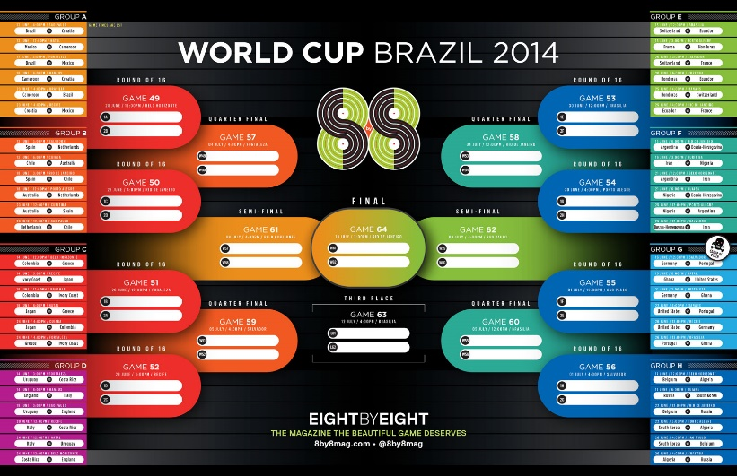
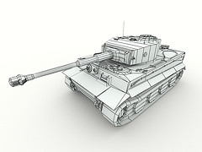
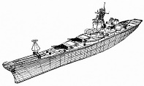
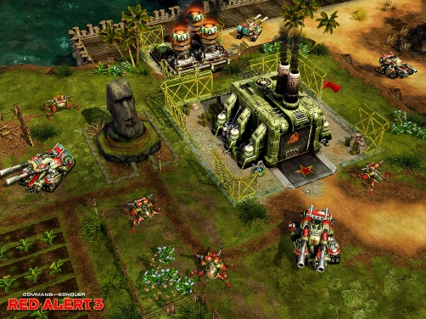
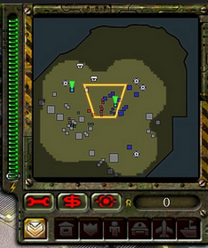
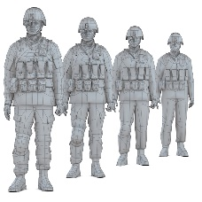

Ranked Multiplayer Battle Matching
Dual Screen Interface
Units and Commandos are Customizable

Slide 6

Gameplay
Commando
Receive Mission
Follow Mission
Attack Commander
Attack Enemy
Commander
Gather Resources
Build Structures
Deploy Troops
Hire Commando for Tasks
Destroy Enemy Commander(s)

Slide 7




Slide 8
$325,000 First Year
$485,000 For 1.5 Year Production Cycle
$692,857 Revenue Required to Cover Costs after Store Fees
Apple takes ~30% of iPhone, iPad sales
Google takes ~30% of Android sales
Steam take ~30% of PC/MAC sales
New Orleans State and Local Tax 4% + 5% = 9% Total Tax
$761,381 after taxes
After 30% Tax Credit Incentive with cash-out of 85% value
of expenditures if over $300,00 (25.5%)
TOTAL COST
$743,907 after incentive

Slide 9
Number of Copies
Quantity _{Commander} x Price _{Commander} +
Quantity _{Commando} x Price _{Commando} = $743,907
Preliminary Assumptions:
Price _{Commander} = $9.99
Price _{Commando} = $0.99
Quantity _{Commander} = 2 x Quantity _{Commando}
Quantity _{Commando} = 123,053 Units _{Commando}
Quantity _{Commander} = 62,148 Units _{Commander}

Slide 10

Questions?
Let’s open this up for discussion.

Slide 11
References
Slide 1
http://venturebeat.com/wp-content/uploads/2013/03/kickstarter-logo.jpg
https://hrbusinessuk.files.wordpress.com/2012/03/judges-panel.jpg
Slide 2
http://pngimg.com/upload/grenade_PNG1351.png
http://upload.wikimedia.org/wikipedia/commons/a/a7/Fairbairn-Sykes_knife.jpg
http://www.hpdz.net/images/Take5/622px-US-O7_insignia.svg.png
Slide 3
http://usarmy.vo.llnwd.net/e2/c/images/2013/03/04/284289/original.jpg
http://rack.3.mshcdn.com/media/ZgkyMDE0LzA5LzE5L2MwL2lQaG9uZV82My40OGQ1OC5qcGcKcAl0aHVtYgk5NTB4NTM0IwplCWpwZw/d08618a4/9a1/iPhone_63.jpg
Slide 4
http://faadooindia.com/wp-content/uploads/2012/07/5312_Women-gamers_faadooindia.com_.jpg
http://www.mobilegeeks.com/wp-content/uploads/2014/11/Man-using-tablet.jpg
http://www.futura-online.com/blog/wp-content/uploads/2010/12/starcraft_2.jpg
http://gamingbolt.com/wp-content/uploads/2012/10/troopers_PC1.jpg
Slide 5
https://8by8mag.com/wp-content/uploads/2013/03/88_WC_BRACKET2.jpg
https://farm7.staticflickr.com/6106/6263009391_5bac9dd0ff_m.jpg
http://img3.wikia.nocookie.net/__cb20091221205717/cnc/images/f/f4/RA_Cruiser_Wireframe.jpg
http://media.moddb.com/images/games/1/12/11116/RedAlert3_screen28.jpg
http://garethrhodes.files.wordpress.com/2014/02/men___male_celebrity_arnold_schwarzenegger_in_film_commandos_057143_.jpg
Slide 6
http://fc08.deviantart.net/fs70/i/2011/155/a/5/storybook_by_kairisk-d3i2av3.jpg
Slide 7
http://nil.cs.uno.edu/courses/csci4670/fall14/15%20Games%20Industry.pdf
Slide 10
http://www.ntdsdictionary.org/ntdbParticipants/images/userGroupPic.gif

